Slide 1

1
2
0
4
5
3

Slide 2
Enjoy The Presentation

Slide 3




Information & Communication Technology
Realised by Group 22
ICT
Professeur: Bouchekir
USTHB

Slide 4
1
4
Impact
Introduction
Components
2
5
Tools
Plan
3
6
Role In Society
Conclusion

Slide 5

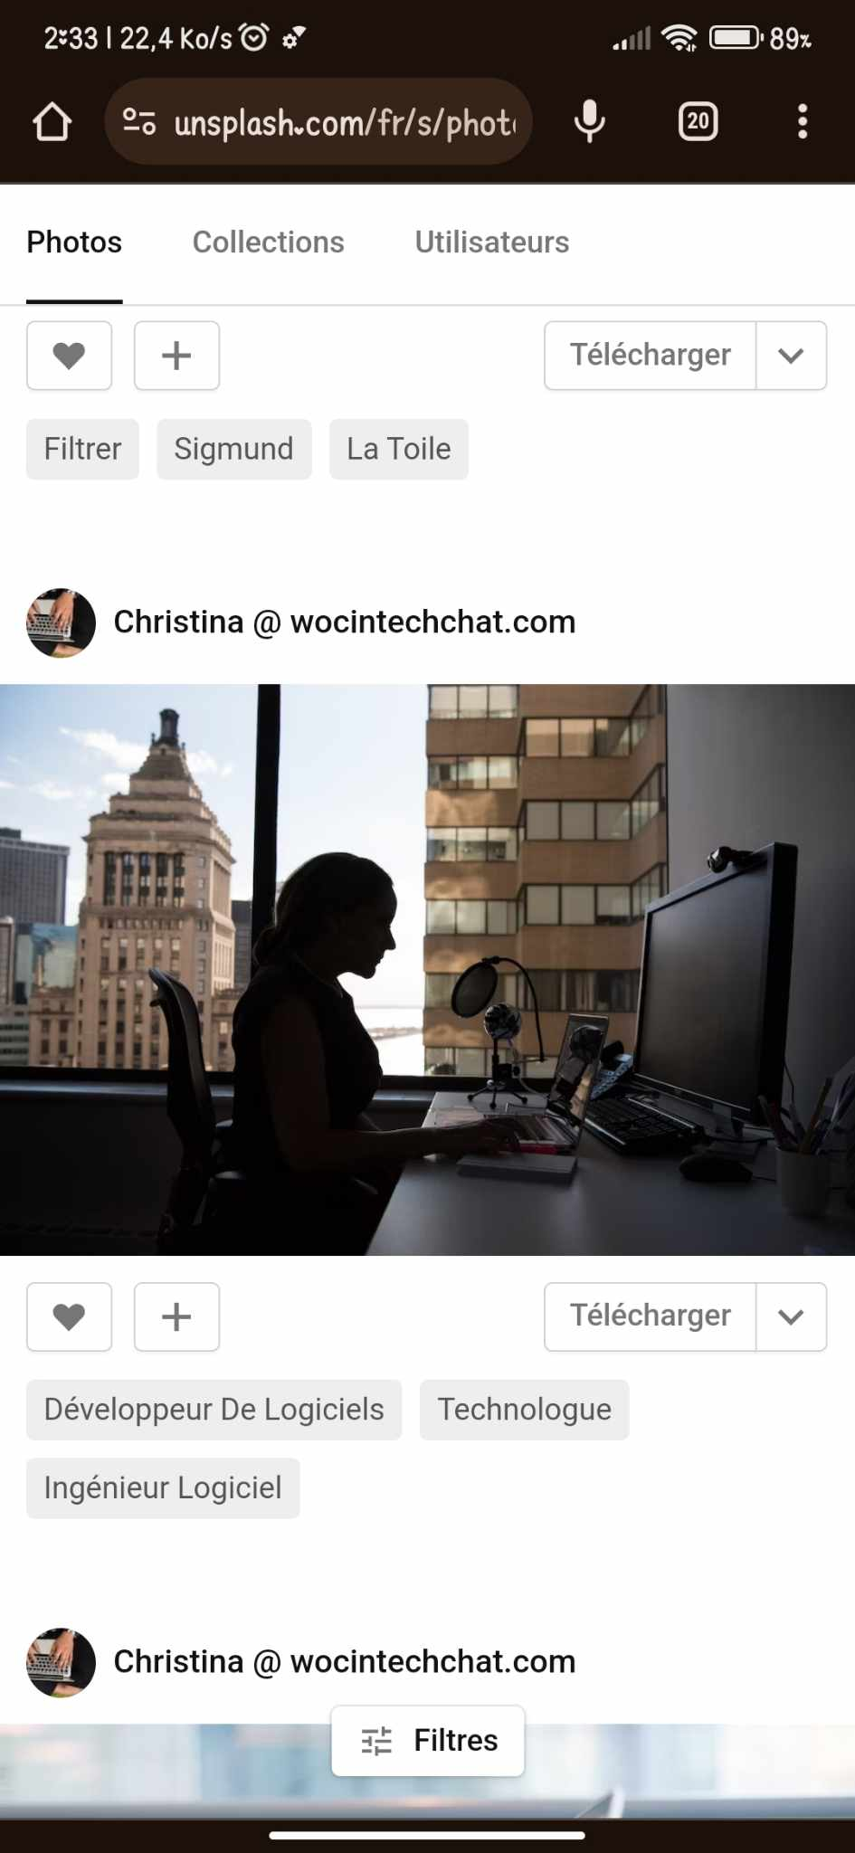
INTRODUCTION:
Understanding ICT doesn't require mastering every technical detail. But by appreciating its broad reach and potential, we can become more informed users, responsible citizens, and active participants in shaping a future where technology serves humanity for the greater good.
So, whether you're a tech enthusiast or a curious newcomer, welcome to the fascinating world of ICT ! It's a journey worth exploring, with limitless possibilities waiting to be discovered.
Group 22

Slide 6

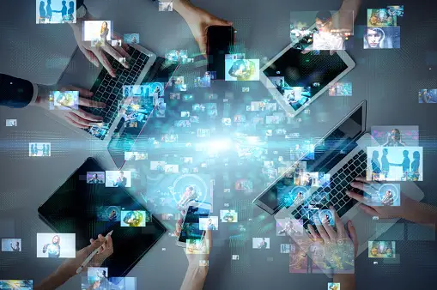
What is ICT ?
Information and communication technologies (ICT) is an umbrella term that encompasses all the technologies used for the acquisition, processing, storage, and transmission of information.
.
This is the broadest definition, encompassing all the technologies used for the acquisition, processing, storage, and transmission of information. This includes everything from computers and mobile devices to networks, software, and the internet itself.

Slide 7





Components
ICT
Information
Data
Middleware
Software
Networks
Hardware

Slide 8




Role of ICT in society:
Communication and connection
Access to information and education
Government and public services
Economic growth and development

Slide 9


Negative Impacts:
Positive Impacts:
Digital Divide,
Addiction and Mental Health,
Cybersecurity Threats,
Global Collaboration
Job Displacement,
Engaging Learning Experiences
Ethical Considerations
Personalized Learning
Remember, ICT is just a tool. How we use it is what truly matters. Let's strive to harness the power of ICT for positive change and create a better world for all.
Democratization of Knowledge
Empowering Communities

Slide 10
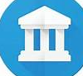








Tools:
Google services
Google art and culture:
allows users
to explore and experience art, culture, and
historical artefacts from around the world.
Google translate:
Users can input text in one language and receive the translated text in another language. This can be done for individual words, phrases, sentences, or entire documents.
Google books:
is a digital library and online service offered by Google, enabling users to search, preview, and
read a vast collection of
books.
Google maps :
is a web-based mapping service provided by Google that offers various features related to geographic mapping, navigation, and location-based services. It allows users to view maps, get directions, find local businesses, and more.
Google cloud:
is a comprehensive suite of cloud computing services provided by Google. These services include infrastructure as a service (IaaS), platform as a service (PaaS), and software a service (SaaS) offerings.
YouTube :
is a video-sharing platform and website that allows users
to upload, share, and view videos. It was created in
February 2005 and later acquired by Google in November 2006. YouTube has become one of the most popular and widely used online platforms for sharing video content.
Gmail:
is a free web-based email service provided by Google. It was first introduced as an invitation-only beta release on April 1, 2004, and later became available to the public on February 7, 2007. Gmail quickly gained popularity due to its innovative features, large storage capacity, and efficient search capabilities.

Slide 11
Microsoft tools:
Office suite: is a collection of productivity software applications bundled together to provide users with a comprehensive set of tools for various tasks related to office work and document management...
Teams: is a collaboration platform developed by Microsoft. It is part of the Microsoft 365 suite of productivity tools and serves as a hub for teamwork, enabling users to communicate, collaborate, share files, and hold meetings within a single integrated environment.
Power BI: short for Power Business Intelligence, is a suite of business analytics tools developed by Microsoft. It allows users to visualize data, share insights across an organization, or embed them in an app or website.
Windows OS: refers to a family of graphical operating systems developed and marketed by Microsoft. Microsoft Windows dominates the personal.
One drive: developed by Microsoft, is a cloud-based file hosting and synchronization service. It allows
users to store files and data in the
cloud, making them accessible from
various devices.
Visual studio code:( VS Code) is a free and open-source source-code editor developed by Microsoft. It is a lightweight and versatile code editor that supports a wide range of programming languages .
SQL: which stands for Structured Query Language, is a standardized programming language designed for managing and manipulating relational databases. It is used to interact with relational data base management systems (RDBMS) or for relational database-like structures.

Slide 12
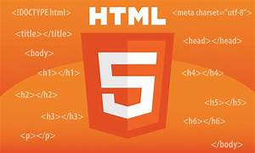

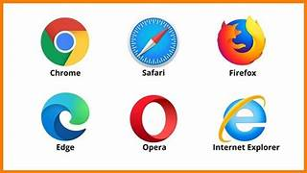

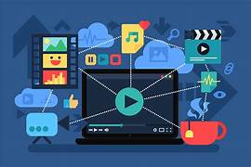
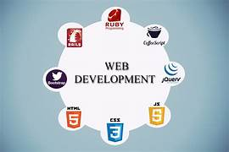
Internet and web technology:
web browsers:
Hypertext Mark up Language(HTML):
Hypertext Transfer Protocol (HTTP):
often simply referred to as a
“browser”, is a software application used to access and navigate the World Wide Web. It allows users to view and interact with web pages, multimedia content, and other online resources.
Is the standard mark-up language used to create and design documents on the World Wide Web. It is the backbone of web content and provides a structured way to organize and present information, including text, images, links, forms, and multimedia.
is an application protocol used for transmitting hypermedia documents, such as HTML. It is the foundation of data communication on the World Wide Web and is used for transferring various types of media .
web server:
multimedia content:
web development & standards :
A software or hardware stores, processes, and delivers web content to
clients over the Internet. It plays a crucial role in the client-server model of the World Wide Web, handling requests from web browsers and serving web pages, files, and other resources to users.
Multimedia content refers to content that incorporates a combination of different media
elements, such as text, images, audio, video, animations, and interactive elements.
refer to the
tools, programming languages, frameworks, and software components that developers
use to create, build, and maintain websites and web applications.
are guidelines and specifications set by organizations to ensure consistency,
interoperability, and best practices in the design and development of websites and web
applications.

Slide 13


Git and GitHub:
Git: is a distributed version control system (DVCS) designed to track changes in source code during software development. Created by Linus Torvalds, Git allows multiple developers to collaborate on projects efficiently. It provides mechanisms to manage different versions of files, track changes, and coordinate work among team members.
GitHub: is a web-based platform that provides
hosting for Git repositories and adds collaboration
features. It serves as a central hub for software
development, allowing developers to share and
collaborate on projects.

Slide 14




Conclusion:
ICT has profoundly transformed our world, offering immense potential for progress and development. However, we must navigate its challenges responsibly, ensuring equitable access, addressing ethical concerns, and mitigating potential harms. The future of I ICT lies in harnessing its power for good, while safeguarding against its downsides.

Slide 15


Thank you for your attention

